Slide 1

6th Grade Math
Unit 6, Lesson 6 Using Two-Column Tables of Equivalent Ratios Volume 1, pg. 282

Slide 2


Benchmarks
MA.6.AR.3.3
Extend previous understanding of fractions and numerical patterns to generate or complete a two- or three-column table to display equivalent part-to-part ratios and part-to-part-to-whole ratios.
MA.6.AR.3.5
Solve mathematical and real-world problems involving ratios, rates, and unit rates, including comparisons, mixtures, ratios of lengths and conversions within the same measurement system.
volume 1, pg. 282

Slide 3
Integrated Mathematical Thinking and Reasoning Standards
MA.K12.MTR.5.1 Use patterns and structure to help understand and connect mathematical concepts.
MA.K12.MTR.7.1 Apply mathematics to real-world contexts.
volume 1, pg. 282

Slide 4

Learning Targets
I can use two-column tables to display equivalent ratios.
I can solve problems using two-column tables of equivalent ratios.
volume 1, pg. 282

Slide 5

Warm-Up
volume 1, pg. 282

Slide 6
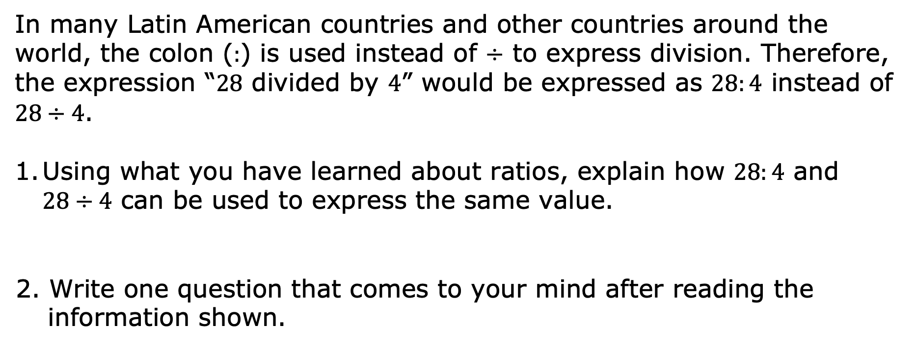
6.6.1 Warm-Up: Different Ways of Expressing Division
In many Latin American countries and other countries around the world, the colon ($:$) is used instead of $÷$ to express division. Therefore, the expression “$28$ divided by $4$” would be expressed as $28:4$ instead of $28÷4$.
Using what you have learned about ratios, explain how $28:4$ and $28÷4$ can be used to express the same value.
2. Write one question that comes to your mind after reading the information shown.
volume 1, pg. 282

Slide 7

Exploration
volume 1, pg. 283

Slide 8

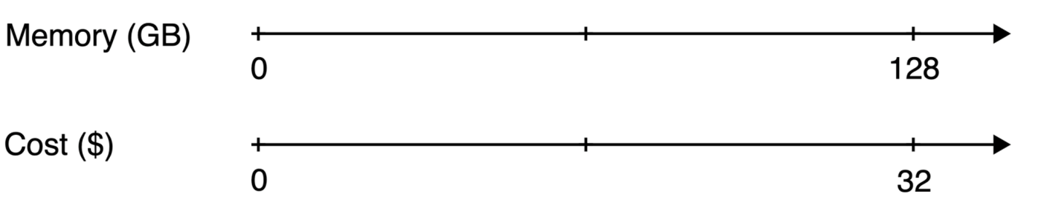
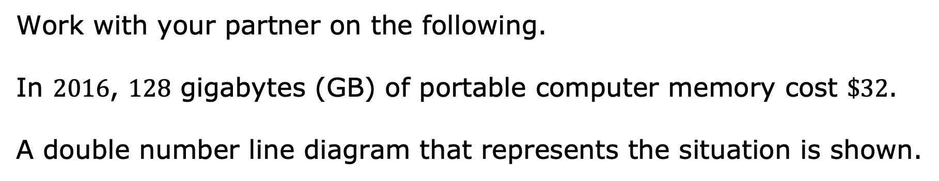
6.6.2 Exploration: Double Number Lines Versus Two-Column Tables
Work with your partner on the following.
In $2016$, $128$ gigabytes (GB) of portable computer memory cost $\$32$.
A double number line diagram that represents the situation is shown.
volume 1, pg. 283

Slide 9
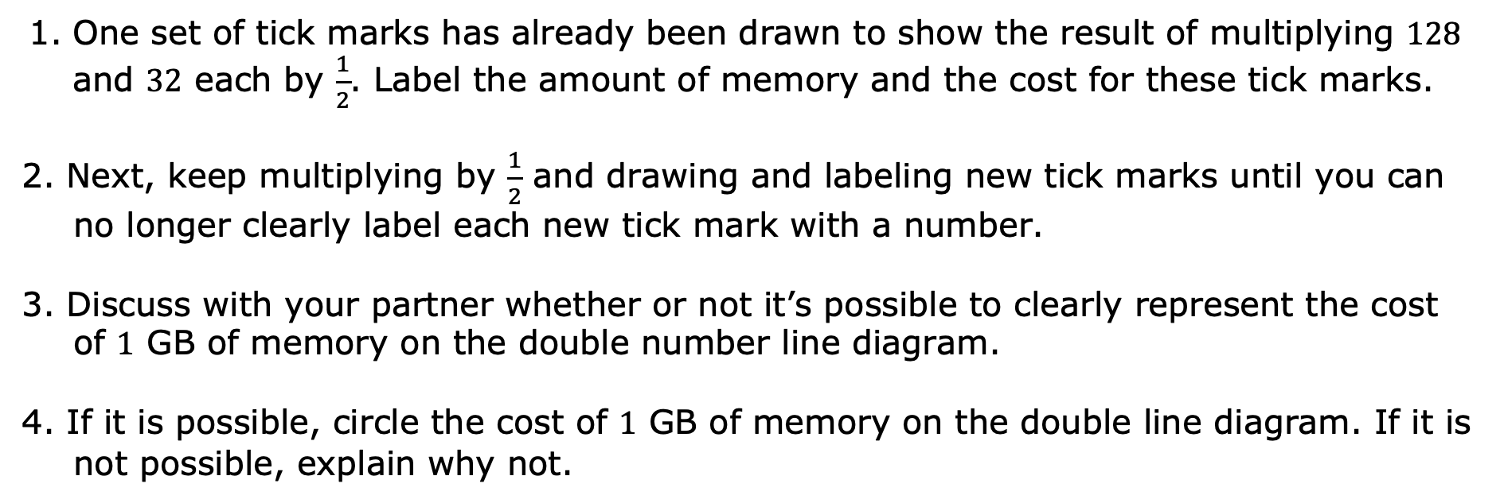
One set of tick marks has already been drawn to show the result of multiplying $128$ and $32$ each by $\frac{1}{2}$. Label the amount of memory and the cost for these tick marks.
2. Next, keep multiplying by $\frac{1}{2}$ and drawing and labeling new tick marks until you can no longer clearly label each new tick mark with a number.
3. Discuss with your partner whether or not it’s possible to clearly represent the cost of $1$ GB of memory on the double number line diagram.
4. If it is possible, circle the cost of $1$ GB of memory on the double line diagram. If it is not possible, explain why not.
volume 1, pg. 283

Slide 10
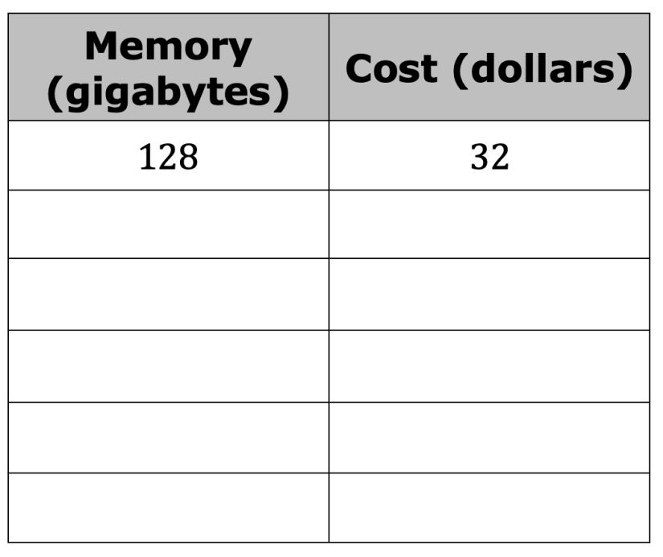
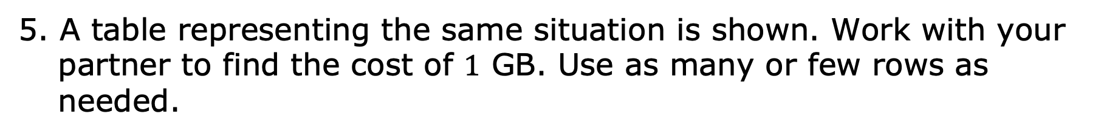
5. A table representing the same situation is shown. Work with your partner to find the cost of $1$ GB. Use as many or few rows as needed.
volume 1, pg. 283

Slide 11
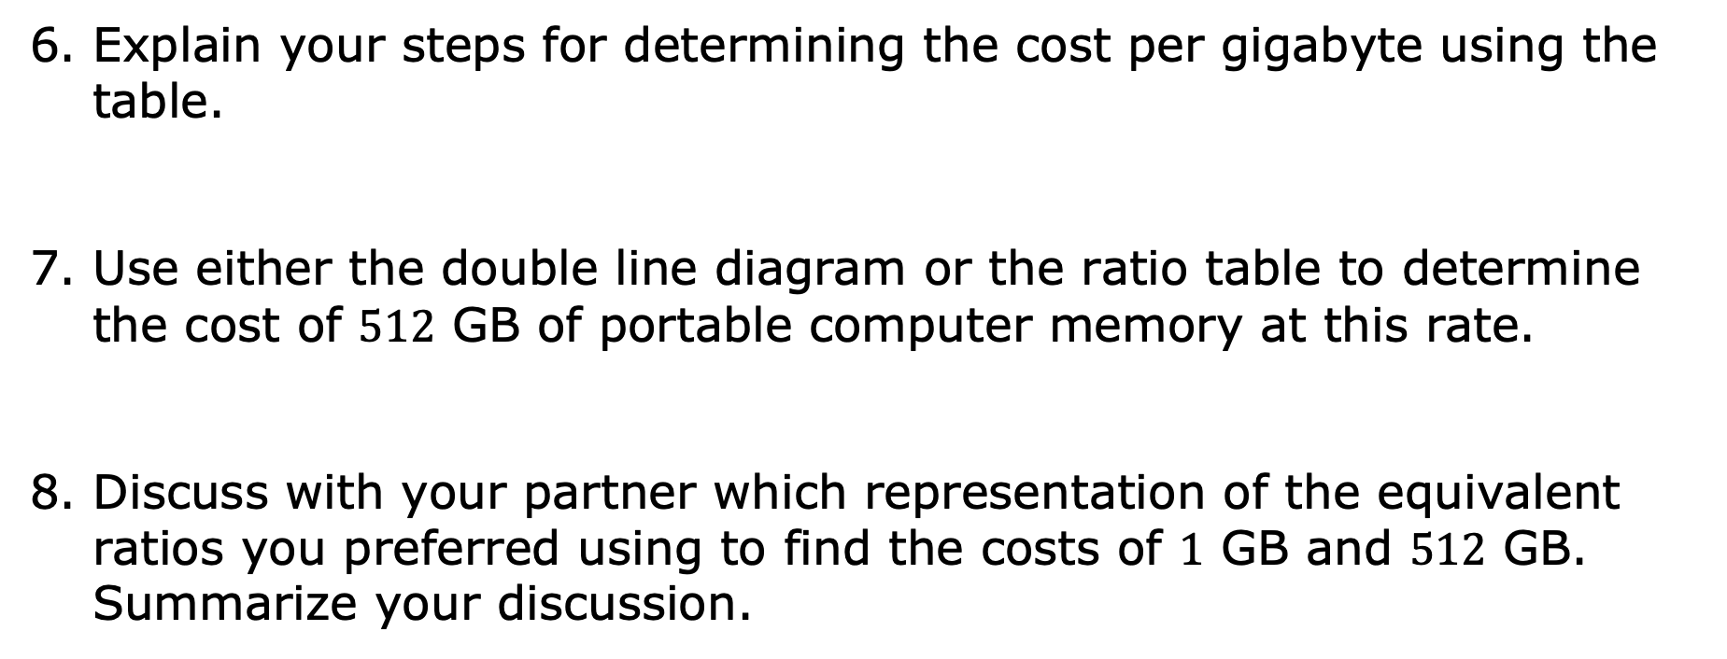
6. Explain your steps for determining the cost per gigabyte using the table.
7. Use either the double line diagram or the ratio table to determine the cost of $512$ GB of portable computer memory at this rate.
8. Discuss with your partner which representation of the equivalent ratios you preferred using to find the costs of $1$ GB and $512$ GB. Summarize your discussion.
volume 1, pg. 283

Slide 12


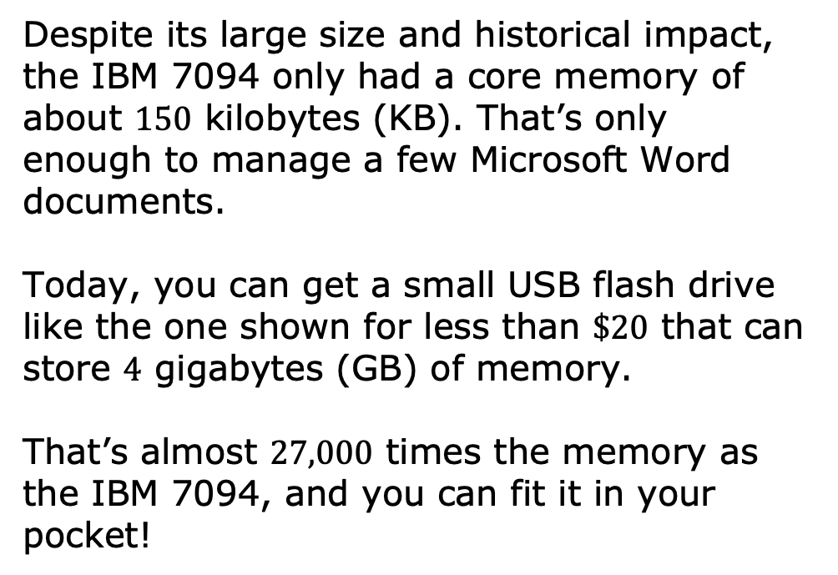
The IBM 7094 was regarded as one of the most powerful advanced mainframe computers in the early 1960s. NASA and the Air Force used it in the Gemini and Apollo space programs.
Despite its large size and historical impact, the IBM 7094 only had a core memory of about $150$ kilobytes (KB). That’s only enough to manage a few Microsoft Word documents.
Today, you can get a small USB flash drive like the one shown for less than $\$20$ that can store $4$ gigabytes (GB) of memory.
That’s almost $27,000$ times the memory as the IBM 7094, and you can fit it in your pocket!
volume 1, pg. 284

Slide 13

Guided Instruction
volume 1, pg. 284

Slide 14
6.6.3 Guided Instruction: Using Two-Column Ratio Tables
Both double number lines and tables can be useful tools for finding equivalent ratios, but there is an important distinction between the two representations. On a double number line, the numbers on each line are listed in order.
With a table, ratios can be written in any order. For this reason, sometimes a table is easier to use to solve a problem.
volume 1, pg. 284

Slide 15
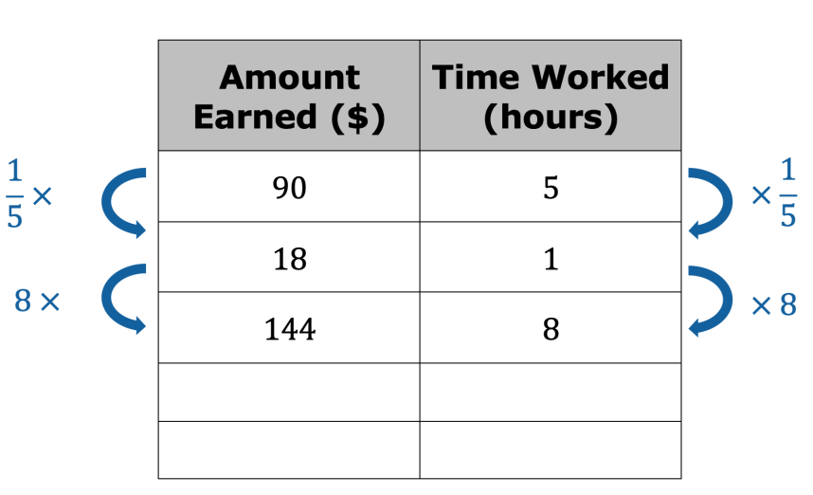
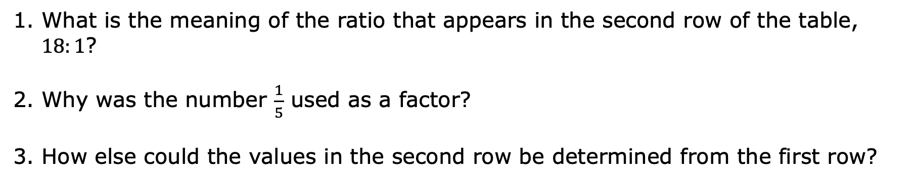
Lin is paid $\$90$ for $5$ hours of work. She used the following table to calculate how much she would be paid at this rate for $8$ hours of work.
What is the meaning of the ratio that appears in the second row of the table, $18:1$?
2. Why was the number $\frac{1}{5}$ used as a factor?
3. How else could the values in the second row be determined from the first row?
volume 1, pg. 284

Slide 16
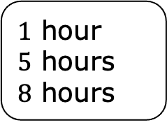
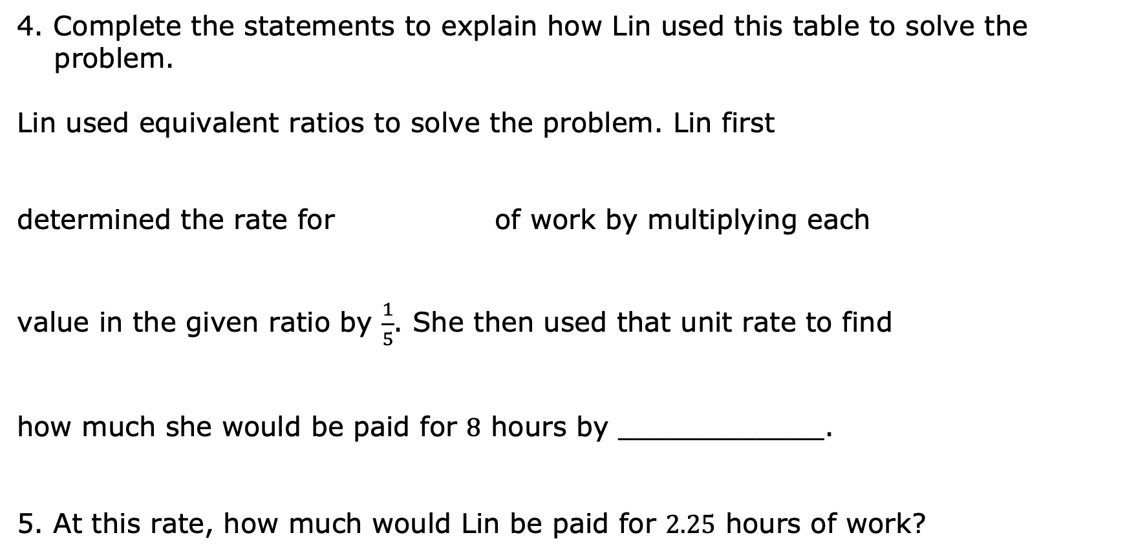
4. Complete the statements to explain how Lin used this table to solve the problem.
Lin used equivalent ratios to solve the problem. Lin first
determined the rate for of work by multiplying each
value in the given ratio by $\frac{1}{5}$. She then used that unit rate to find
how much she would be paid for $8$ hours by ____________.
5. At this rate, how much would Lin be paid for $2.25$ hours of work?
$1$ hour
$5$ hours
$8$ hours
volume 1, pg. 285

Slide 17

Guided Practice
volume 1, pg. 285

Slide 18

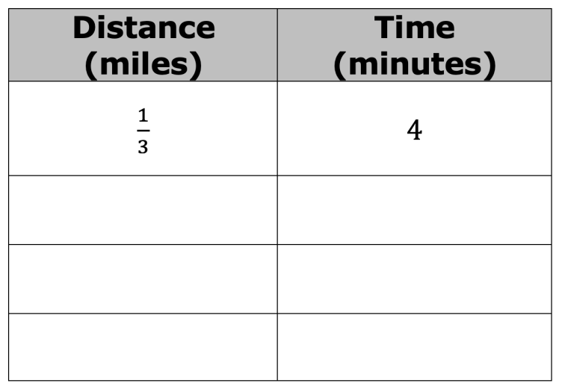
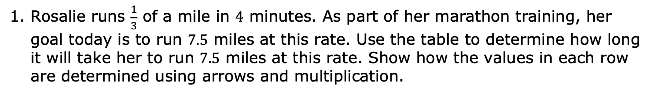
6.6.4 Guided Practice: Using Two-Column Ratio Tables
Rosalie runs $\frac{1}{3}$ of a mile in $4$ minutes. As part of her marathon training, her goal today is to run $7.5$ miles at this rate. Use the table to determine how long it will take her to run $7.5$ miles at this rate. Show how the values in each row are determined using arrows and multiplication.
volume 1, pg. 285

Slide 19

Your Turn
volume 1, pg. 286

Slide 20
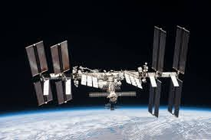
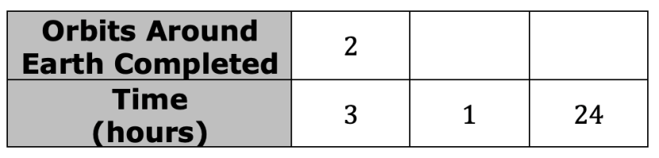
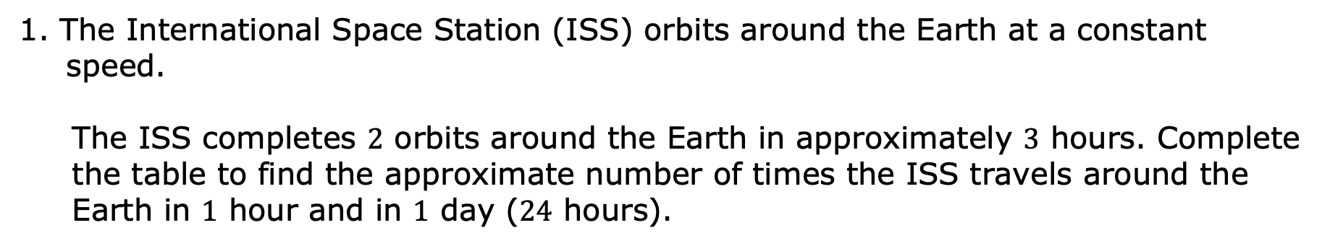
6.6.5 Your Turn!
1. The International Space Station (ISS) orbits around the Earth at a constant speed.
The ISS completes $2$ orbits around the Earth in approximately $3$ hours. Complete the table to find the approximate number of times the ISS travels around the Earth in $1$ hour and in $1$ day ($24$ hours).
volume 1, pg. 286

Slide 21
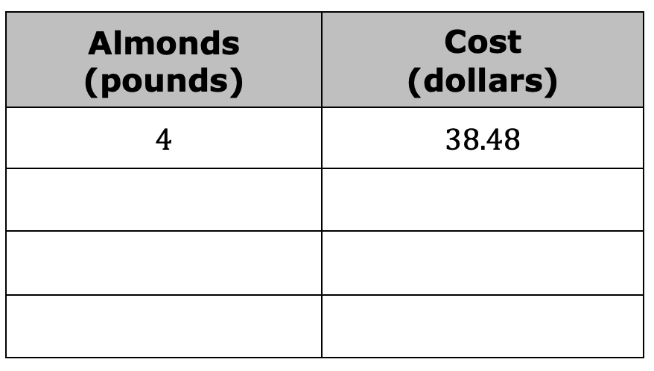
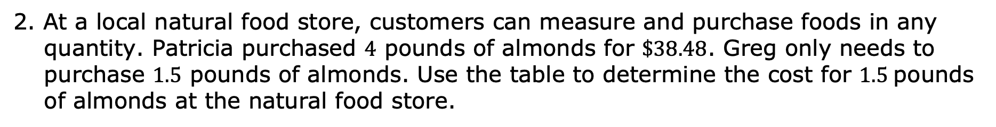
2. At a local natural food store, customers can measure and purchase foods in any quantity. Patricia purchased $4$ pounds of almonds for $\$38.48$. Greg only needs to purchase $1.5$ pounds of almonds. Use the table to determine the cost for $1.5$pounds of almonds at the natural food store.
volume 1, pg. 286

Slide 22

Wrap-Up
volume 1, pg. 287

Slide 23
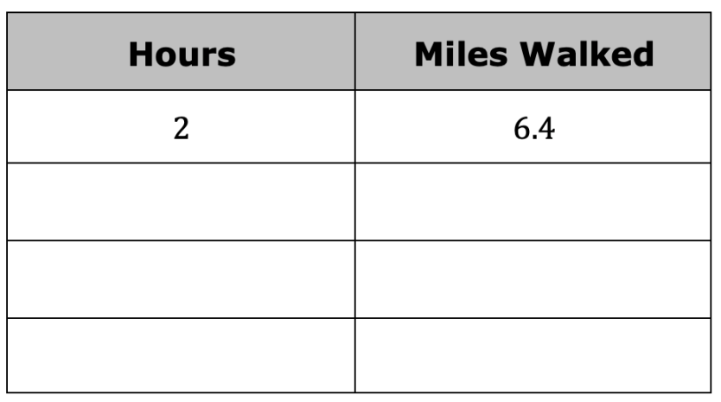
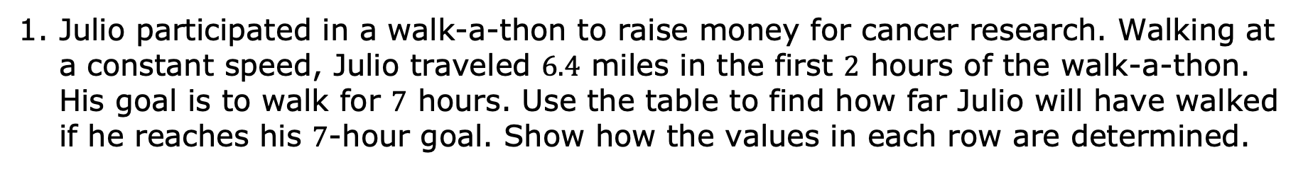
6.6.6 Wrap-Up: Ticket Out the Door
Julio participated in a walk-a-thon to raise money for cancer research. Walking at a constant speed, Julio traveled $6.4$ miles in the first $2$ hours of the walk-a-thon. His goal is to walk for $7$ hours. Use the table to find how far Julio will have walked if he reaches his $7$-hour goal. Show how the values in each row are determined.
volume 1, pg. 287

